Slide 1
CSS
MEET Y2 Summer 2018

Slide 2
Overview
User interfaces: why are they important?
Intro to CSS
How to use CSS in your webpage
Lab # 1
Selectors
id and class attributes
Lab # 2
Notes:
<number>

Slide 3

Notes:
What do you think is the content, appearance, interaction in this page?

Slide 4
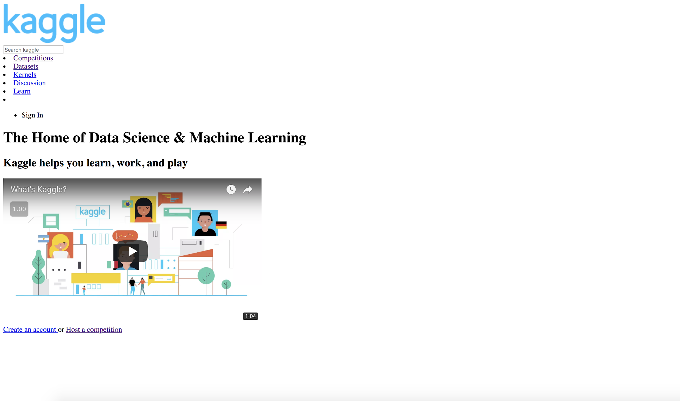


Slide 5
Why are good User Interfaces (UIs) important?
You can have the greatest idea in the world, but if a user can’t use it or doesn’t want to use it, then it won’t make an impact in the world.
What websites do you use a lot?
What do you think makes a website look good or bad?

Slide 6
Why is UI important?
Let’s take a look a couple websites
http://www.roverp6cars.com/
https://involvio.com/
http://www.google.com
http://www.pennyjuice.com/
http://www.montere.it/?lang=en

Slide 7
What makes an amazing website? (aside from having an amazing idea to begin with)

Slide 8
CSS (Cascading Style Sheets)
Specify style outside of individual tags
Separation of content (what’s in the page) and style (how it looks)
Easier to change style without messing up content and vice versa
Notes:
The live demo has
the same website with three different stylesheets
How to use coolors.co
<number>

Slide 9

How to add CSS to your page
A new tag inside your <head>:
A CSS file with some CSS rules
<link rel="stylesheet" type="text/css" href="style.css">
A CSS rule

Slide 10
CSS Lab 1 (if you finish, do extras!) Lab: go.meet.sh/css-lab Slides: go.meet.sh/css-lecture Cheatsheet: go.meet.sh/css-cheat
Notes:
<number>

Slide 11
CSS Lab 1
Make an html page with a header, two paragraphs, and at least one link.
Create a new file called “style.css”. Inside, type
In your HTML file, add this somewhere inside the <head>:
Use coolors.co to pick a better color scheme for this website. Change the colors based on your new scheme, but do not use the style attribute!
body {
background-color: blue;
color: white;
}
<link rel="stylesheet" type="text/css" href="style.css">

Slide 12
CSS Lab 1, Extra
Learn more about color:
Read https://www.smashingmagazine.com/2010/02/color-theory-for-designer-part-3-creating-your-own-color-palettes/
Pick three of your favorite apps or websites, and explain which palette style they use.
Make another CSS file called style_alternate.css. Try your website with another color scheme.

Slide 13
CSS Selectors
A way of picking different HTML elements on the page
Lets us give different styles to different elements

Slide 14
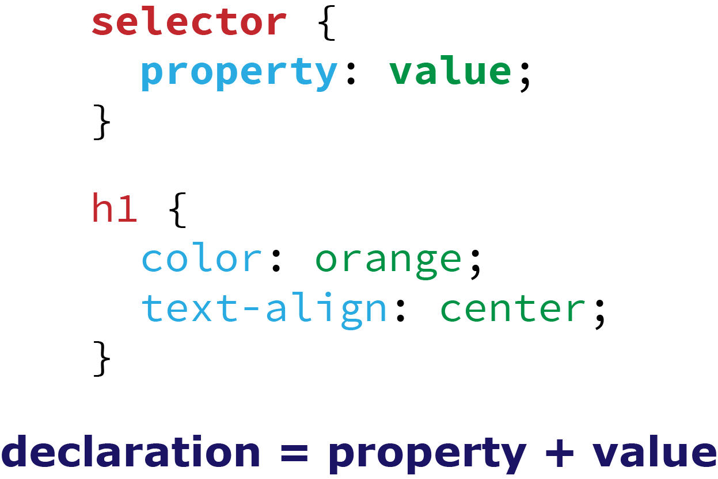
CSS Selectors
Selector: picks some elements to change
Property: says what to change about them
Value: says what to change it to

Slide 15
Tag Selectors
A way of picking all of a kind of tag
To pick all <p> tags: p { color: green; }
To pick all <h1> tags: h1 { color: green; }
p { color: green; }

Slide 16
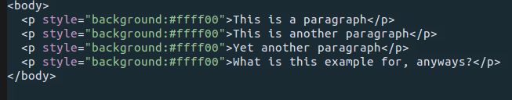
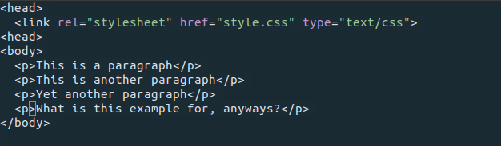
Tag Selectors
Makes it very easy to affect a large number of tags
This:
Is way worse than this:
Notes:
<number>

Slide 17
An example
<html>
<head>
<style>
p { color: green; }
</style>
</head>
<body>
<p>The first paragraph</p>
<p>The second paragraph</p>
<p>The third paragraph</p>
</body>
</html>

Slide 18
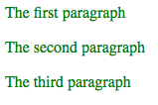
An example
<html>
<head>
<style>
p { color: green; }
</style>
</head>
<body>
<p>The first paragraph</p>
<p>The second paragraph</p>
<p>The third paragraph</p>
</body>
</html>

Slide 19
Going beyond tag selectors
<html>
<head>
<style>
p { color: green; }
</style>
</head>
<body>
<p>The first paragraph</p>
<p>The second paragraph</p>
<p>The third paragraph</p>
</body>
</html>
What if we want to make only the second paragraph green?
What if we want to make the last two paragraphs green?

Slide 20
Back to HTML: id and class attributes
These are for categorizing your elements
The id attribute is for giving a name to a single element on your page
You should never have more than one element with the same ID!
The class attribute is for saying that many elements are in the same “family”

Slide 21
ID selectors
Use an ID selector:
Hashtag sign, then the id
#coolest { color: green; }
<html>
<head>
<style>
#coolest { color: green; }
</style>
</head>
<body>
<p>The first paragraph</p>
<p id=“coolest”>The second paragraph</p>
<p>The third paragraph</p>
</body>
</html>

Slide 22
Class selectors
Class selector
Period, then the class name
.important { color: yellow; }
<html>
<head>
<style>
.important { color: yellow; }
</style>
</head>
<body>
<p>The silly first paragraph</p>
<p class=“important”>The second paragraph</p>
<p class=“important”>The third paragraph</p>
</body>
</html>

Slide 23
CSS Lab 2 Lab: go.meet.sh/css-lab Slides: go.meet.sh/css-lecture Cheatsheet: go.meet.sh/css-cheat
Notes:
<number>

Slide 24
CSS Lab 2: selectors
To get checked off, make sure you’re using a good color scheme for all the colors!
Use a CSS tag selector to change the color of all links.
Add a list of six favorite foods to your website. Use CSS class selectors to make vegetarian foods one color and non-vegetarian foods a different color.
Use a CSS id selector to give one element on your page a different background color.
Using Google and/or w3schools, find out what the following properties do. To get checked off, show each of them off on your website and explain them to your TA.
font-family
font-size

Slide 25
CSS Lab 2: Selectors - Extras
Pick one element in your page and give it a class and an ID. Then, add three CSS rules to style that element: one with a tag selector, one with a class selector, and one with an ID selector. Which one gets used? What happens if you have only two rules?
Find or add two <p> and two <a> elements on your webpage and give all four of them the same class “muggle”. What happens if you use the selector “p.muggle”? How about “a.muggle”? Explain these selectors to your TA to get checked off.
Add a form to your website. You should have at least three checkboxes and one radio button. Add a CSS rule that makes selected checkboxes turn blue.

Slide 26
Positioning
Notes:
<number>

Slide 27

Positioning
So you want to move the items on your page around…
Like having the sidebar to the right of your main content.
CSS can help!
Header
Sidebar
Main Content
Body
Notes:
<number>

Slide 28
The position property
This property tells the element where to go on the page. There are a few values it can take:
static: default; leaves element in its normal position
relative: positions it relative to its normal position
absolute: positions it relative to its first positioned parent
Has to be inside an element with a position that is not static
fixed: positions it relative to the browser window (follows when you scroll)
Notes:
<number>

Slide 29
Directions
If the position isn’t static (we’ll assume it isn’t from now on):
You need to set:
top or bottom
and
left or right
Basically, pick one direction like this: and one like this:
Notes:
<number>

Slide 30
Position
The positions you give using top, bottom, left, right affect the element differently depending on its position value:
relative: the element is offset from its normal position
Original position (static)
Notes:
<number>

Slide 31
Position
The positions you give using top, bottom, left, right affect the element differently depending on its position value:
relative: the element is offset from its normal position
40px
Original position (static)
New position:
position: relative;
top: 40px;
Notes:
<number>

Slide 32
Directions
absolute: the element is offset from its first positioned ancestor
40px
10px
New position:
position: absolute;
top: 40px;
left: 10px;
(this element has position: relative)
(this element has no specified position)
Notes:
<number>

Slide 33
Position
fixed: the element is offset from the browser window
40px
Content
10px
New position:
position: fixed;
top: 40px;
left: 10px;
What will happen if you scroll down?
This is now the browser window
Notes:
The element is still in the same place relative to your window even though you scrolled!
Useful for stuff like a sidebar, or a back-to-top button
<number>

Slide 34
Position
fixed: the element is offset from the browser window
Content
40px
40px
Content
10px
10px
New position:
position: fixed;
top: 40px;
left: 10px;
New position:
position: fixed;
top: 40px;
left: 10px;
Scroll down
This is now the browser window
Notes:
The element is still in the same place relative to your window even though you scrolled!
Useful for stuff like a sidebar, or a back-to-top button
<number>

Slide 35
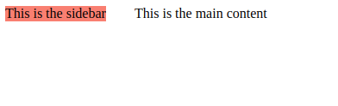
Example
You can use the position property, like this:
HTML:
<body>
<div class=”container”>
<div class=”sidebar”>
This is the sidebar
</div>
<div class=”main”>
This is the main
</div>
</div>
</body>
CSS:
.container {
position: relative;
}
.sidebar {
position: absolute;
top: 0px;
left: 0px;
}
.main {
position: absolute;
top: 0px;
left: 150px;
}
Notes:
<number>

Slide 36
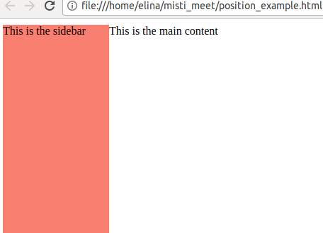
Width and height
This looks a bit weird… the sidebar ends when the text ends! Not very practical
What if we want to have the sidebar and main content touch?
Or have the sidebar go all the way down the page?
Much better
Notes:
<number>

Slide 37
Width and height
We can use the width and height properties to specify the size of any element:
.sidebar {
position: absolute;
top: 0px;
left: 0px;
width: 150px;
height: 100%;
background: salmon;
}
Notes:
<number>

Slide 38
Width and height (again)
2 ways to specify width and height of an element
Absolute
Units (like pixels)
Percentage
% of the containing block
Notes:
<number>

Slide 39
Width and height
width: 100%
height: 50%
width: 700px
height: 400px
Notes:
<number>

Slide 40
Width and height
width: 25%
height: 250px
width: 700px
height: 400px
Notes:
<number>

Slide 41
Width and height
Also works with browser windows:
width: 100%
height: 50px
Browser window
(variable width and height)
What could these dimensions be used for in a real page?
Notes:
Possible answers:
Title banner
Toolbar
Announcements
<number>

Slide 42

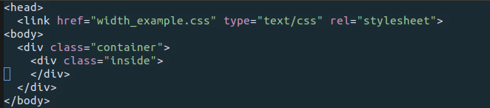
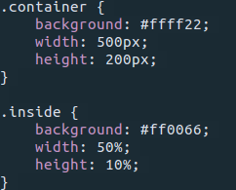
Width and height math
HTML
CSS
What will the width and height of the “inside” div be?
Notes:
<number>

Slide 43
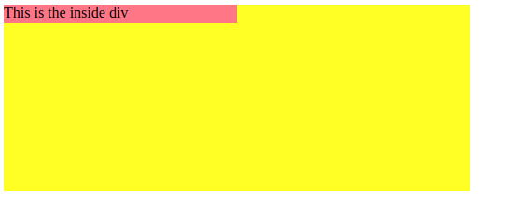
Width and height math
HTML
CSS
Width: 250px Height: 20px
Notes:
<number>

Slide 44
Lab 3 Lab: go.meet.sh/css-lab Slides: go.meet.sh/css-lecture Cheatsheet: go.meet.sh/css-cheat
Notes:
<number>

Slide 45
Lab 3: Hints
Organization of content (in the file):
How the page should look:
title
title
container
sidebar
content
sidebar
content
Notes:
<number>

Slide 46
Spacing & the “box model”
Notes:
<number>

Slide 47
Spacing
Our sidebar still looks a little strange, right?
No space in between start of <div> and the words...
Tons of space everywhere!
This is a job for padding and margins.
Notes:
<number>

Slide 48
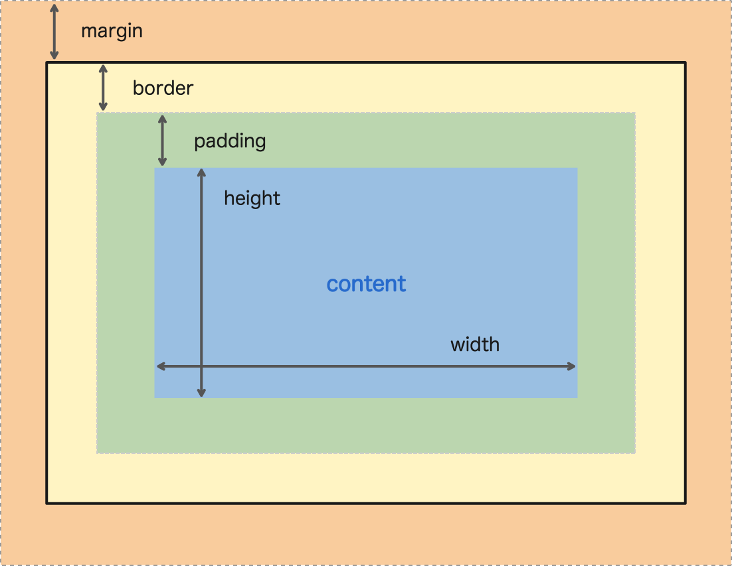
Box Model
Content – your stuff.
Could be any kinds of tags.
Padding – extends your stuff to give the content more room inside its background
Border – The real end of your stuff, can be styled to be pretty
Margin – space around your stuff
Notes:
<number>

Slide 49
Padding and margins
How to specify padding & margins: same way as for width and height
Units (usually used)
Percentages (remember, these are relative to the containing block)
Can specify all of the sides at once, or one at a time (using left, right, top, bottom):
selector {
padding: 10px;
margin: 5px;
}
selector {
padding-left: 10px;
padding-right: 15px;
margin-top: 5px;
}
Notes:
<number>

Slide 50
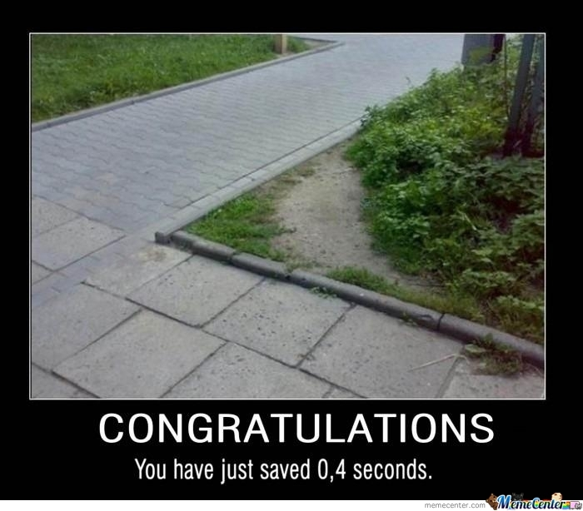
Padding and margins
A cool short way to specify all the sides at once, if you have different values for each side, is like this:
selector {
padding: 1px 2px 3px 4px;
}
top right bottom left
top
It goes clockwise around the content:
left
Content
right
bottom
Notes:
<number>

Slide 51
Padding and margins
If you have 2 conflicting property statements, the second one is going to be used, not the first one
Example :
selector {
padding: 10px;
padding-left: 30px;
}
This will make the left padding be 30px, and the rest be 10px.
Notes:
<number>

Slide 52
Padding and margins
More shortcuts:
padding: 10px;
padding: 10px 5px;
padding: 10px 5px 15px;
padding: 10px 5px 15px 20px;
margin-left: 10px;
margin-right: 5px;
margin-top: 15px;
margin-bottom: 20px;
padding: 10px;
padding-top: 40px;
10px on all sides
10px on top and bottom, 5px left and right
10px top; 5px left and right, 15px bottom
10px top, 5px right, 15px bottom, 20px left
Left margin is 10px
Right margin is 5px
Top margin is 15px
Bottom margin is 20px
In this case, the padding on the top is 40px, and the rest is 10px. It has to be in this order to work.
Notes:
<number>

Slide 53


Borders
You need to have the thickness, style, and color specified:
selector {
border: 5px solid red;
}
You can also choose specific sides (like for padding and margins:
selector {
border-left: 2px dotted blue;
border-top: 2px dashed green;
}
For more style options see cheat sheet at go.meet.sh/css-cheat
Notes:
<number>

Slide 54
Box model: problem
The width of an element is not just the value of the width property by default!
To calculate the total width:
total width = width + padding (left and right) + margin (left and right) + border (left and right)
So you have to account for this extra width from the padding, margins, and borders by making the width property smaller.
So annoying!!!
Notes:
<number>

Slide 55
Box model fix
You just need to set this property:
* {
box-sizing: border-box;
}
( * selects all the elements on the page)
And the width you set will be the total width of the element!
total width = width
So easy :)
Notes:
<number>

Slide 56
Lab 4 Lab: go.meet.sh/css-lab Slides: go.meet.sh/css-lecture Cheatsheet: go.meet.sh/css-cheat
Notes:
<number>

